Slide 1
SAP Silent Install

Slide 2
Agenda
Purpose of SAP silent install
Setting up a good base for the install
Setup process and key elements
Executing the command
Monitoring the install process
Cleaning up
Restarting the process on the same VM
Starting a new install with existing ‘seed’ files

Slide 3
Prerequisites
A successful interactive installation on a separate VM to:
Validate all installation media
Install all necessary OS or DB patches/hot fixes
Set pagefile to required size
The target VM should be prestine for the silent install

Slide 4
Creating the SAP inifile.xml
The inifile.xml captures your SAP installation configuration parameter values
Generated by SAPInst install interaction
Specific to the SAP application
Specific to the underlying infrastructure and file structure

Slide 5
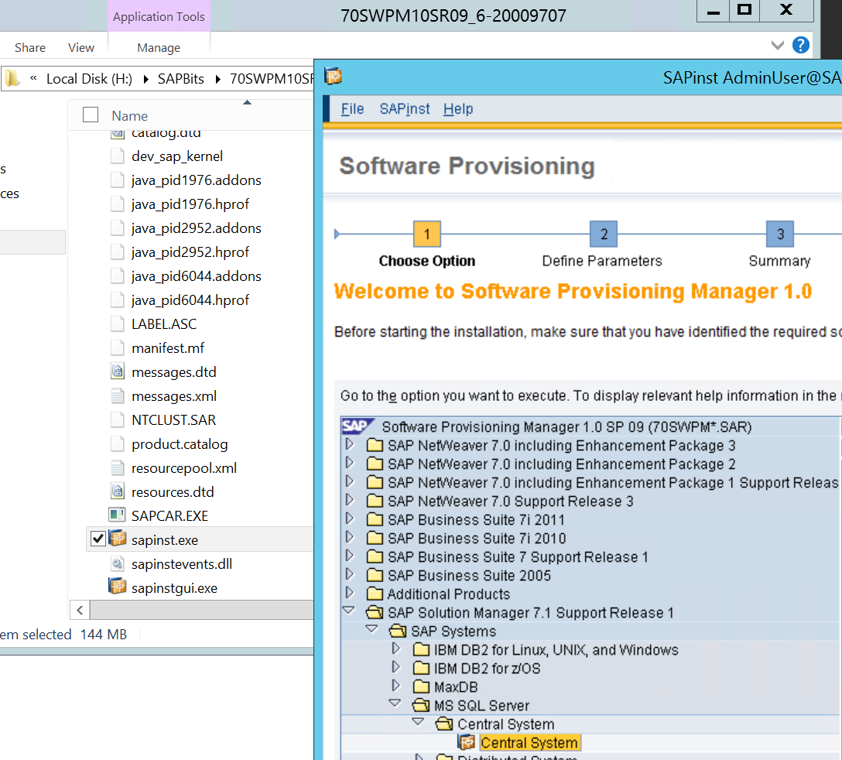
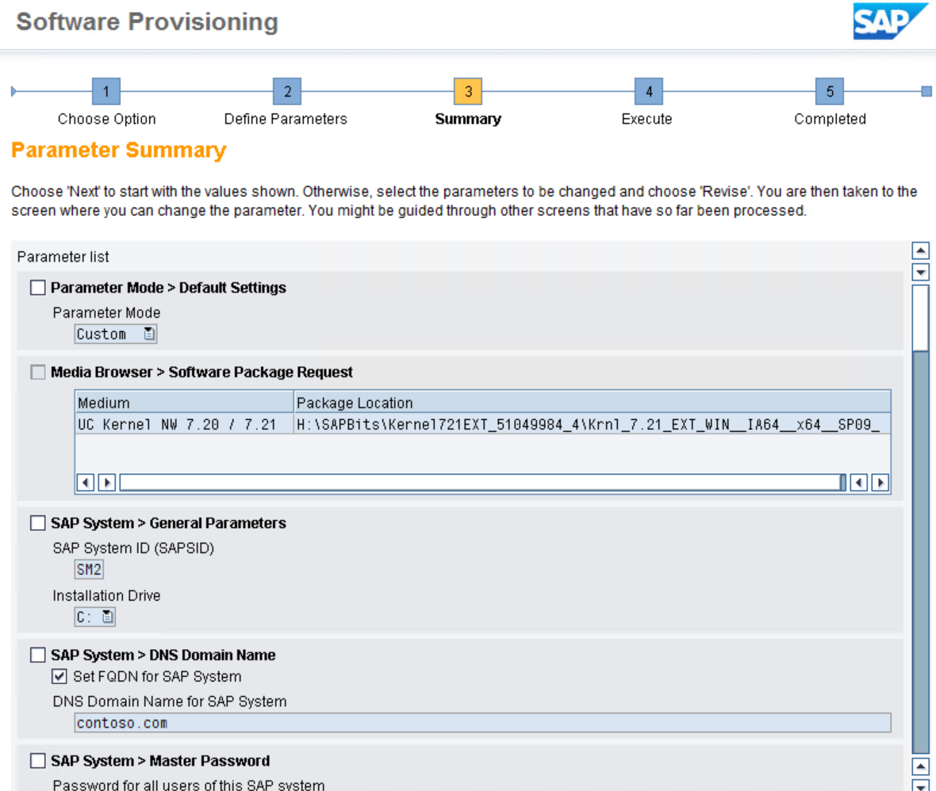
SAPInst sample steps
Stop your interaction with SAPinst at the Summary screen and go copy the inifile.xml file from your SAP installation directory by default is at C:\Program Files\sapinst_instdir and drop it in your silent install directory. Then terminate SAPinst and ensure it completely exist by checking on Task Manager

Slide 6
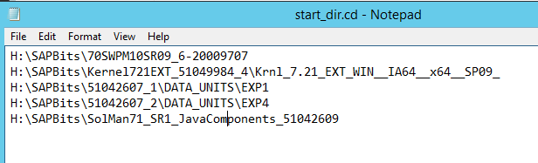
Create the Start_dir.cd file
Start_dir.cd file lists the paths to the SAP installation media (install DVDs)

Slide 7

Key elements
Inifile.xml – SAP install initialization file contains target instance configuration info generated by SAPinst
Keydb.dtd – Doc type definition for keybd.xml file, tables definition and content needed during the service execution
Doc.dtd – Doc type definition used by SAPinst documentation
The above 3 files come from the SAP install dir.
Start_dir.cd – file listing install media paths

Slide 8
Setup process
Step through SAPinst interactively to generate the inifile.xml
Create the start_dir.cd file by listing all paths to install media
Create an install directory at any location with any name
Drop the inifile.xml, doc.dtd, keydb.dtd, start_dir.cd files onto the install directory just created
Find the PRODUCT_ID from the inifile.xml embedded in the installation service statement at the beginning of the file (tail- end of a long string)

Slide 9
Install execution
Set PATH variable to include the Software Deployment Manager (SWPM) so the SAPinst command can be found
Change directory to the install dir you created
Execute SAPinst with variables:
SAPINST_PARAMETER_CONTAINER_URL=inifile.xml
SAPINST_EXECUTE_PRODUCT_ID (found in inifile.xml)
SAPINST_SKIP_DIALOGS=true
-nogui
-noguiserver

Slide 10
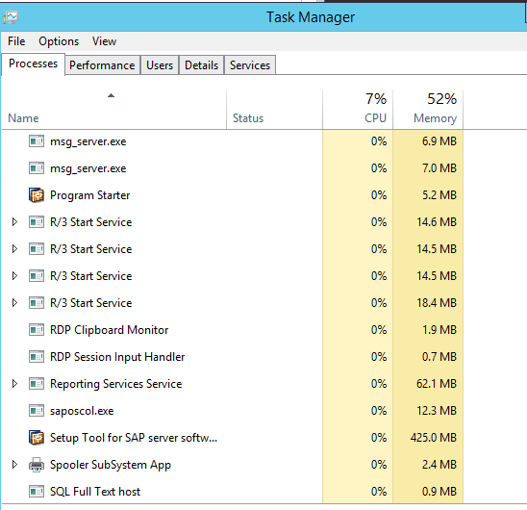
Monitoring at runtime
Logs are written in the install directory where you launch the sapinst command
SAPinst.log
SAPinst_dev.log
Task manager
Individual package import logs

Slide 11
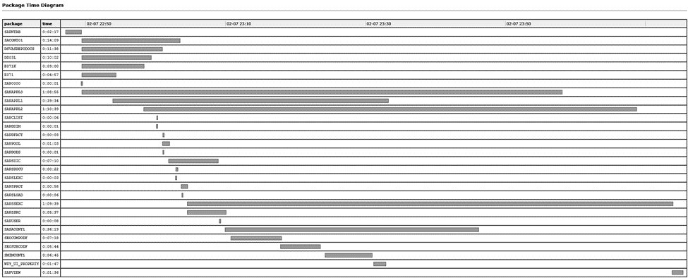
SAPInst load time
Use Time Analyzer (MigTime) per SAP Note 784118 to see load time for each package

Slide 12
In case you need to clean up
Log in as user <sid>adm
Use SAPinst on the SWMP media
Select <product>, software life-cycle options, Uninstall

Slide 13
Restarting silent install on the same VM
Running with the same options W/O clean-up
unknown message ID (syslib.filesystem.creatingFile) with parameter(s): C:\Users\sapadmin\AppData\Local\Temp\2\sapinst_exe.4344.1454978029\dev_sap_kernel_test_09_Feb_2016_00_34_15. Aborted
Changed the SID and rerun resulted in the same error
Depends on the point in time of the failure, one may fix the issue and restart without clean-up

Slide 14
Restarting silent install after clean-up
Removed installed instance via SAPinst (manually)
Remove or rename old install directory
Change directory to the install directory
Restart SAPinst command

Slide 15
Repeating the install on new VMs
Copy the install directory with only the 4 seed files
Ensure target host has identical disk structure and software repo structure
Edit the inifile.xml
Replace the old <sid> with the new one throughout
Change fld name=“TransHost“ strval to your new hostname if the new host is your transport host. Else, keep or change TransHost value
Replace all hostname fields with new host (domain, httphost etc)

Slide 16
Thank you!
Please rate this session at the end of the day.
http://bit.ly/SAPRedmondDay3

